Slide 1
COAL Chapter 3
Week 3
Shoaib Rauf
Courtesy: Dr. Muhammad Nouman Durrani

Slide 2
Basic Program Execution Registers
Registers are high-speed storage locations directly inside the CPU, designed to be accessed at much higher speed than conventional memory
There are eight general-purpose registers, six segment registers, a processor status flags register (EFLAGS), and an instruction pointer (EIP)

Slide 3
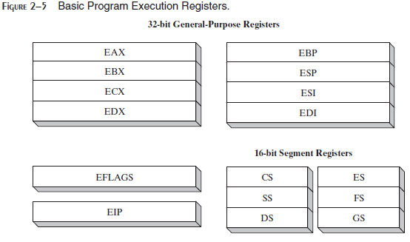

Slide 4
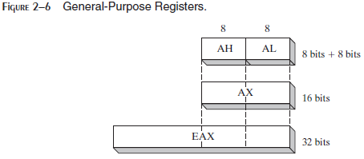
General-Purpose Registers:
The general-purpose registers are primarily used for arithmetic and data movement.
As shown in Figure 2–6, the lower 16 bits of the EAX register can be referenced by the name AX
Portions of some registers can be addressed as 8-bit values
For example, the AX register, has an 8-bit upper half named AH and an 8-bit lower half named AL

Slide 5
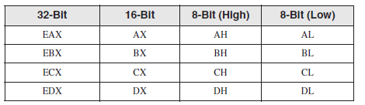
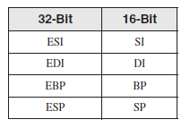
The remaining general-purpose registers can only be accessed using 32-bit or 16-bit names, as shown in the following table:

Slide 6
Specialized Uses of general-purpose registers
Some general-purpose registers have specialized uses:
• EAX (accumulator) - favored for arithmetic operations.
It is automatically used by multiplication and division instructions
EBX (Base) - Holds base address for procedures and variables
ECX - The CPU automatically uses ECX as a counter for looping operations
EDX (Data) - Used in multiplication and division operations

Slide 7
Index Registers
Index Registers contain the offsets for data and instructions.
Offset- distance (in bytes) from the base address of the segment.
• ESP (extended stack pointer register) contains the offset for the top of the stack to addresses data on the stack (a system memory structure)
• ESI and EDI (extended source index and extended destination index ) points to the source and destination string respectively in the string move instructions
• EBP is used to reference function parameters and local variables on the stack

Slide 8
Segment Registers:
In real-address mode, 16-bit segment registers indicate base addresses of pre-assigned memory areas named segments.
In protected mode, segment registers hold pointers to segment descriptor tables (The descriptor describes the location, length and access rights of the memory segment).
Some segments hold program instructions (code), others hold variables (data), and another segment named the stack segment holds local function variables and function parameters.
Instruction Pointer :
The EIP, or instruction pointer, register contains the address of the next instruction to be executed.
Certain machine instructions manipulate EIP, causing the program to branch to a new location.

Slide 9
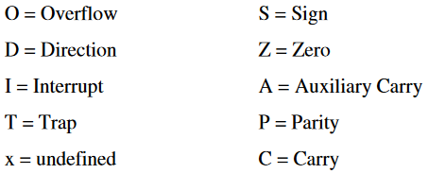
EFLAGS Register:
The EFLAGS register consists of individual binary bits that control the operation of the CPU or reflect the outcome of some CPU operation.
A flag is set when it equals 1; it is clear (or reset) when it equals 0.
Programs can set individual bits in the EFLAGS register to control the CPU’s operation
For example: Interrupt when arithmetic overflow is detected

Slide 10
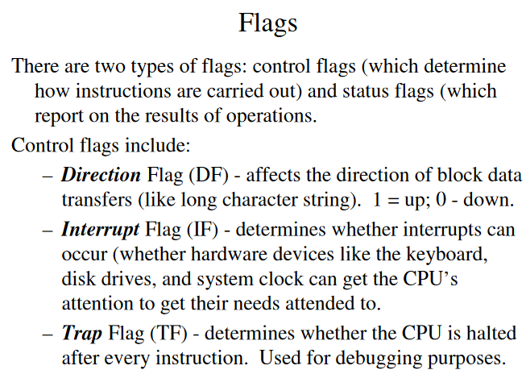

Slide 11
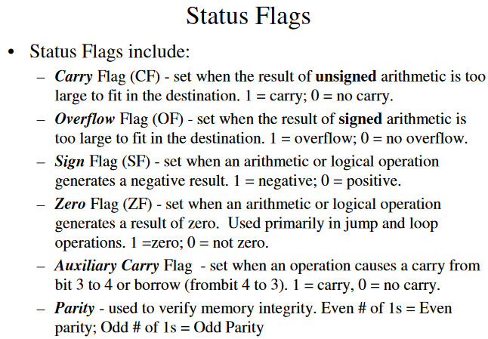
The Status flags reflect the outcomes of arithmetic and logical operations performed by the CPU.
Parity- is set if the least-significant byte in the result contains an even number of 1 bits. It used to verify memory integrity.

Slide 12
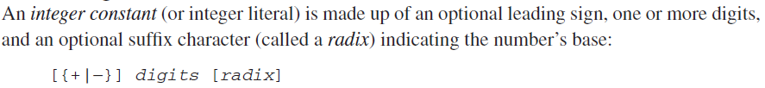
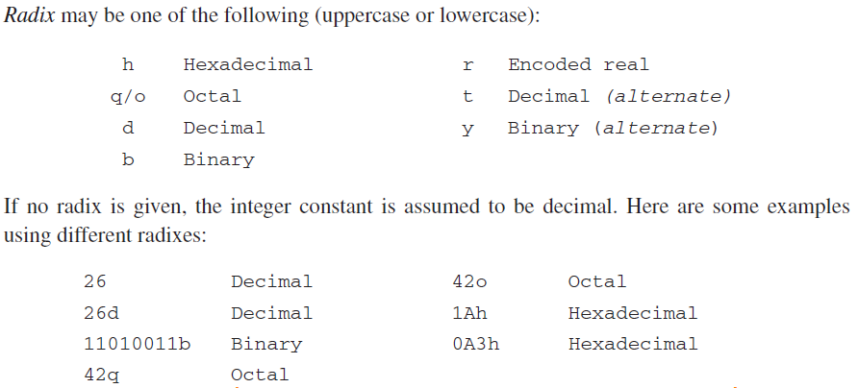
Integer Constants

Slide 13
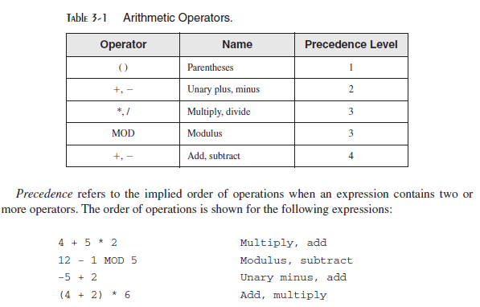
Integer Expressions
An integer expression is a mathematical expression involving integer values and arithmetic operators
The integer expression must evaluate to an integer, which can be stored in 32 bits (0 through FFFFFFFFh)

Slide 14
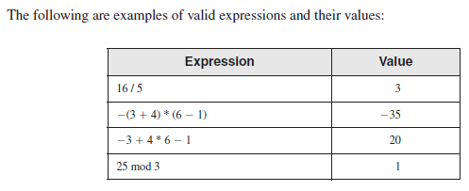

Slide 15
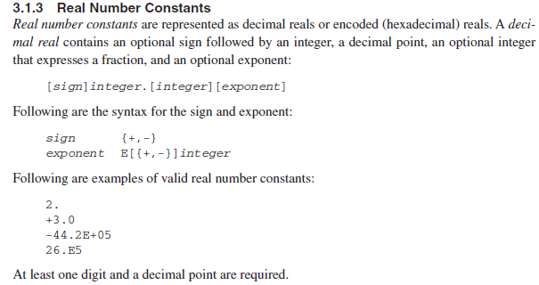

Slide 16
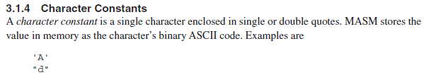

Slide 17
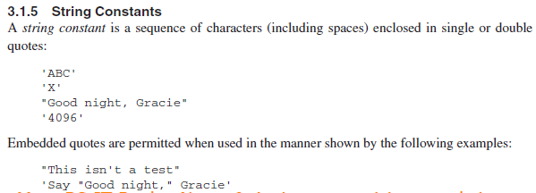
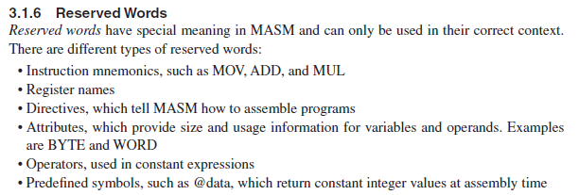

Slide 18
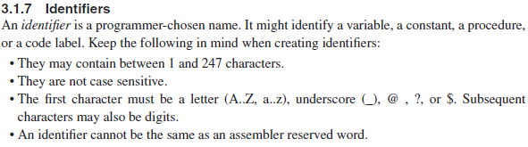
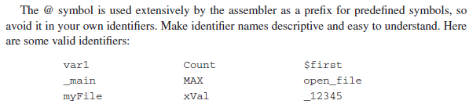

Slide 19
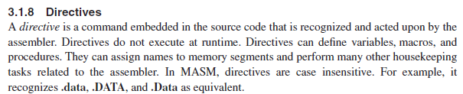
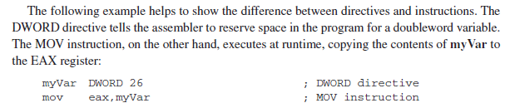
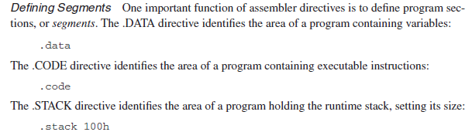

Slide 20
Directives
Commands that are recognized and acted upon by the assembler
Not part of the Intel instruction set
Used to declare code, data areas, select memory model, declare procedures, etc.
not case sensitive
Different assemblers have different directives
NASM not the same as MASM, for example
myVar DWORD 26 ; DWORD directive, set aside
; enough space for double word
Mov eax, myVar ; MOV instruction

Slide 21
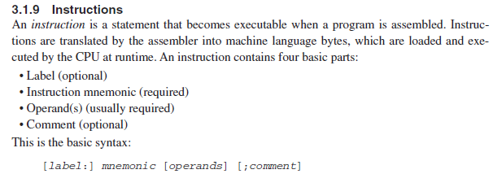

Slide 22
Instructions
An instruction is a statement that becomes executable when a program is assembled.
Assembled into machine code by assembler
Executed at runtime by the CPU
We use the Intel IA-32 instruction set
An instruction contains:
Label (optional)
Mnemonic (required)
Operand (depends on the instruction)
Comment (optional)
Basic syntax
[label:] mnemonic [operands] [ ; comment]

Slide 23
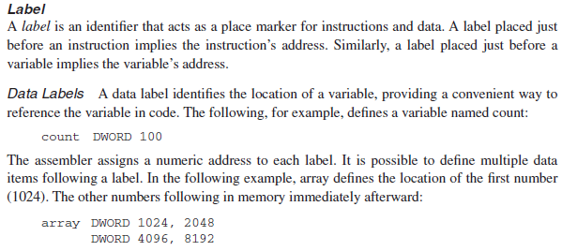

Slide 24
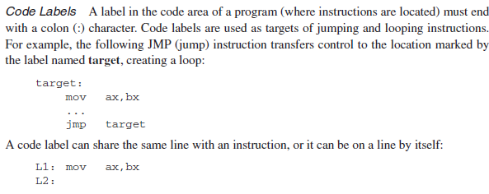

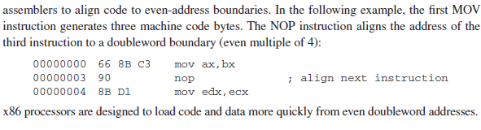

Slide 25
Labels
Act as place markers
marks the address (offset) of code and data
Follow identifier rules
Data label
must be unique
example: myArray (not followed by colon)
count DWORD 100
Code label
target of jump and loop instructions
example: L1: (followed by colon)

Slide 26
Mnemonics and Operands
Instruction Mnemonics
memory aid
examples: MOV, ADD, SUB, MUL, INC, DEC
Operands
constant 96
constant expression 2 + 4
register eax
memory (data label) count
Constants and constant expressions are often called immediate values

Slide 27
Instruction Format Examples
No operands
stc ; set Carry flag
One operand
inc eax ; register
inc myByte ; memory
Two operands
add ebx, ecx ; register, register
sub myByte, 25 ; memory, constant
add eax, 36 * 25 ; register, constant-expression

Slide 28

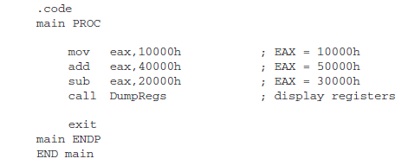

Slide 29
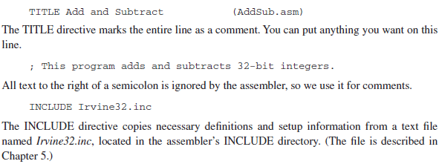

Slide 30
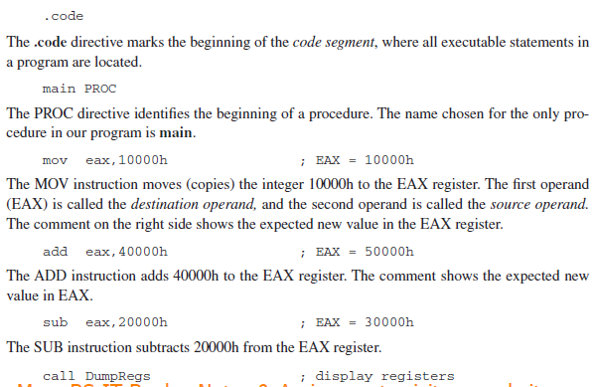

Slide 31
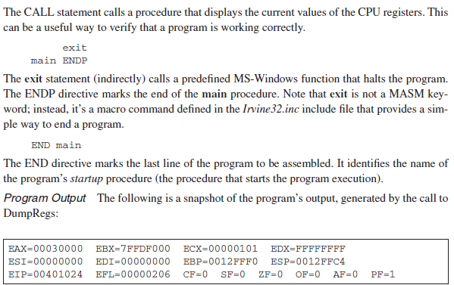

Slide 32
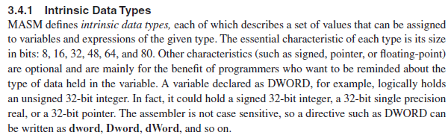

Slide 33
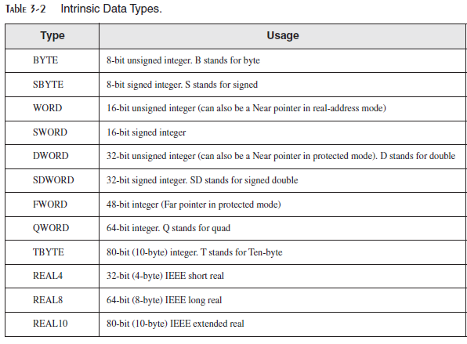

Slide 34
.data
promptUse byte "Enter two integers: ", 0
results byte "Result is: ", 0
.code
main proc
mov esi, offset array
mov ecx, int_count
l1:
mov edx, offset promptUser
call writestring
call readint
mov [esi],eax
add eax, [esi]
add esi, type dword
loop l1
mov edx, offset results
call writestring
call writeint
exit
main endp
end main

